Slide 1
Looking at general accuracy
Compare accuracy on AP and WIT
Accuracy related to self-reported effort/attention
Accuracy related to self-reported IMS/EMS scores
Accuracy related to observer condition

Slide 2
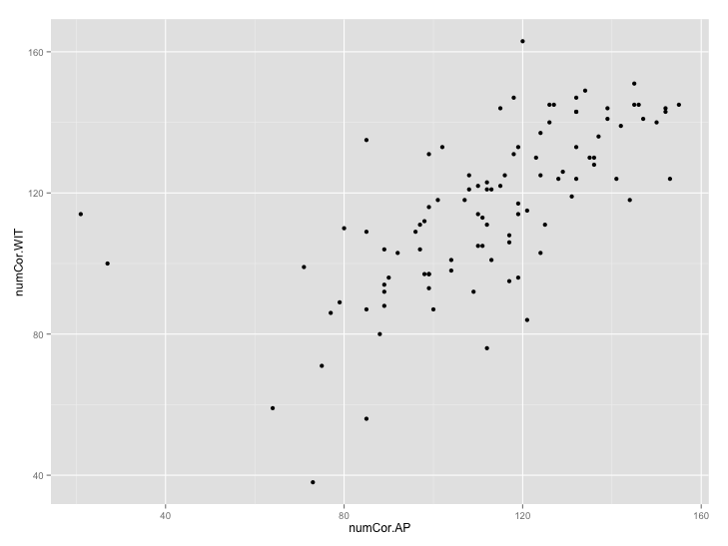
ALL SUBJECTS
Number of correct trials on WIT x AP (out of 192)
All subjects (100 Ss)- excludes 53 because no data
Mean acc (WIT) = 60.4%
Mean acc (AP) = 58.5%

Slide 3
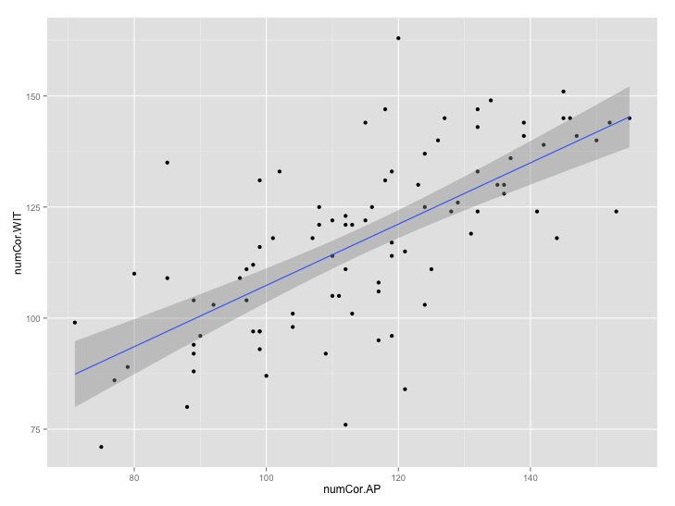
BAD SUBJECTS EXCLUDED
Number of correct trials on WIT x AP (out of 192)
Only includes 90 Ss (excludes both tasks for all bad subs)
Mean acc (WIT) = 61.3%
Mean acc (AP) = 59.4%
Coefficients:
Estimate Std. Error t value Pr(>|t|)
(Intercept) 34.13685 9.21660 3.704 0.00037 ***
numCor.WIT 0.68712 0.07719 8.902 6.54e-14 ***
Residual standard error: 14.57 on 88 degrees of freedom
Multiple R-squared: 0.4738, Adjusted R-squared: 0.4678
F-statistic: 79.24 on 1 and 88 DF, p-value: 6.54e-14

Slide 4
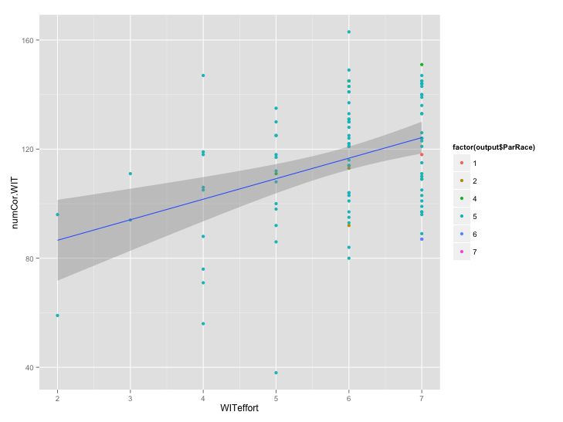
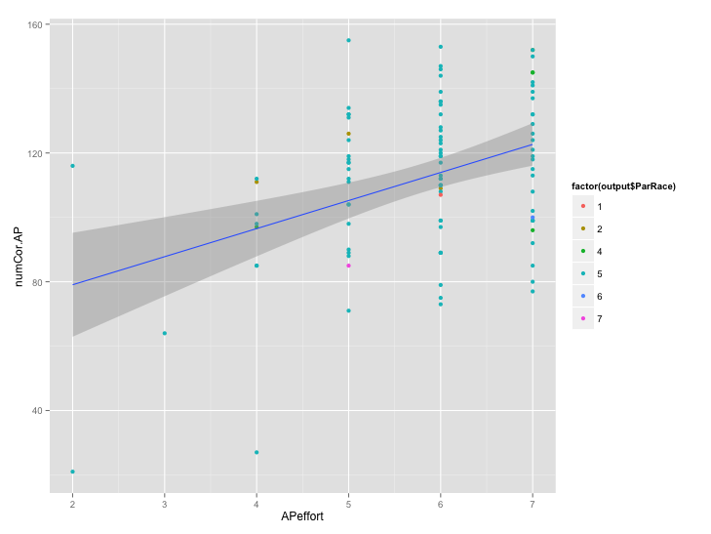
ALL SUBJECTS
Significant relationship between # correct trials and self-reported effort
WIT
AP
Coefficients:
Estimate Std. Error t value Pr(>|t|)
(Intercept) 71.520 11.040 6.478 3.73e-09 ***
WITeffort 7.529 1.836 4.101 8.51e-05 ***
R² = .1465
Coefficients:
Estimate Std. Error t value Pr(>|t|)
(Intercept) 61.627 12.134 5.079 1.81e-06 ***
APeffort 8.720 2.052 4.250 4.88e-05 ***
R² = .1556

Slide 5
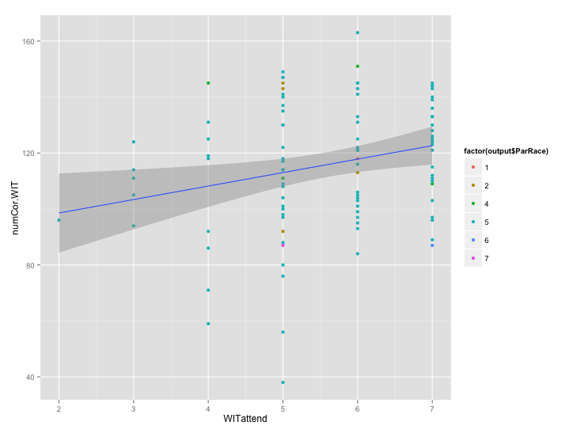
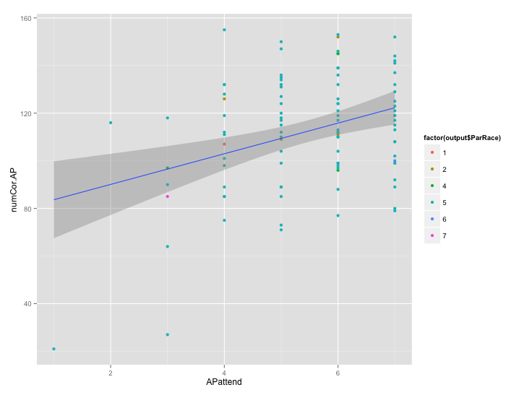
ALL SUBJECTS
Significant relationship between # correct trials and self-reported attention
WIT
AP
Coefficients:
Estimate Std. Error t value Pr(>|t|)
(Intercept) 88.930 10.765 8.261 7.02e-13 ***
WITattend 4.815 1.877 2.565 0.0118 *
R² = .0629
Coefficients:
Estimate Std. Error t value Pr(>|t|)
(Intercept) 77.210 9.840 7.846 5.39e-12 ***
APattend 6.437 1.755 3.667 0.000399 ***
R² = .1207

Slide 6
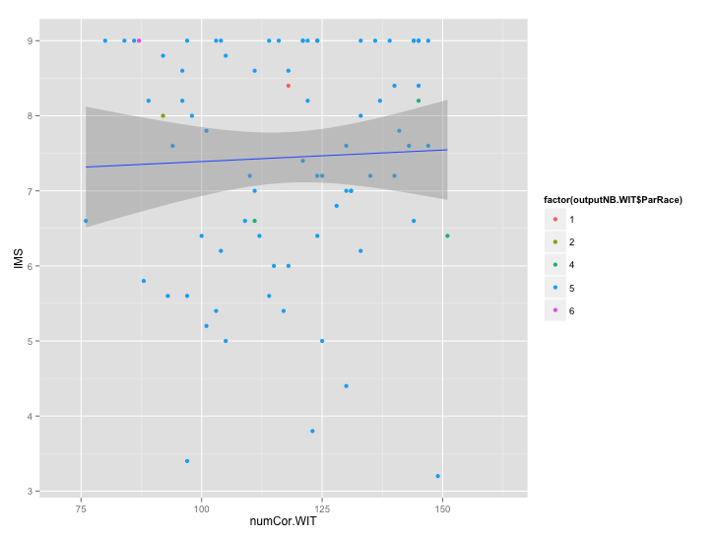
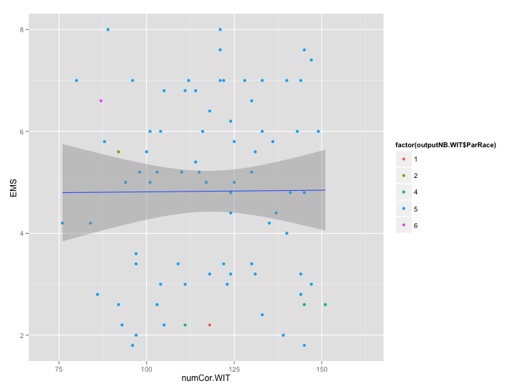
BAD SUBJECTS EXCLUDED
Relationship between # correct trials in WIT and IMS/EMS scores (only 80 Ss with good WIT data and mass pretesting data)
IMS
EMS
Coefficients:
Estimate Std. Error t value Pr(>|t|)
(Intercept) 7.084714 1.046420 6.770 2.15e-09 ***
numCor.WIT 0.003055 0.008757 0.349 0.728
Coefficients:
Estimate Std. Error t value Pr(>|t|)
(Intercept) 4.7478269 1.2443285 3.816 0.000271 ***
numCor.WIT 0.0006544 0.0104130 0.063 0.950049

Slide 7
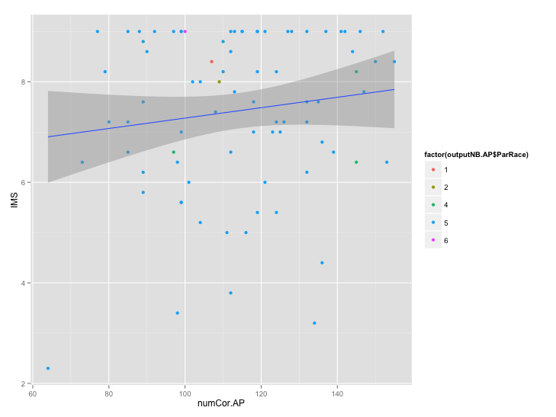
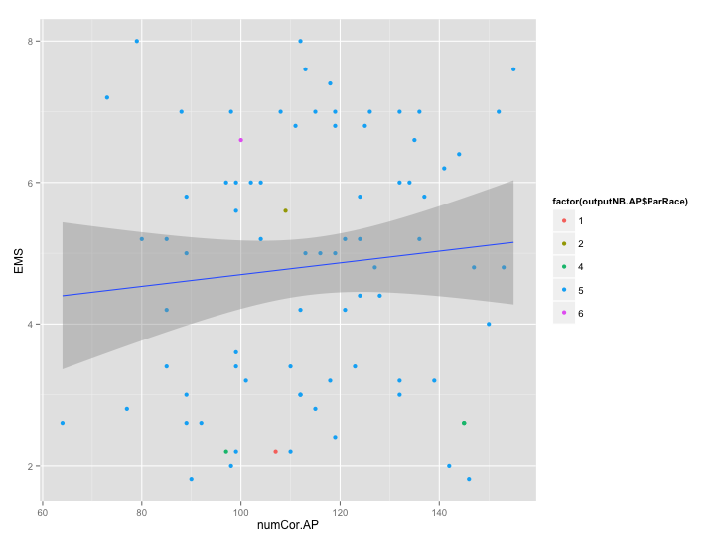
BAD SUBJECTS EXCLUDED
Relationship between # correct trials in AP and IMS/EMS scores (only 81 Ss with good AP data and mass pretesting data)
IMS
EMS
Coefficients:
Estimate Std. Error t value Pr(>|t|)
(Intercept) 6.243815 0.979019 6.378 1.13e-08 ***
numCor.AP 0.010335 0.008436 1.225 0.224
Coefficients:
Estimate Std. Error t value Pr(>|t|)
(Intercept) 3.867764 1.114611 3.470 0.000846 ***
numCor.AP 0.008298 0.009605 0.864 0.390250

Slide 8
BAD SUBJECTS EXCLUDED
Relationship between # correct trials in AP and IMS/EMS scores
No interactions with observer condition
i.e., no relationship between IMS/EMS and accuracy on either AP or WIT, regardless of observer condition
Also, no main effect of observer on accuracy in AP or WIT

Slide 9
Looking at race bias interactions
Look for accuracy in different trial conditions
Examine total errors, timeout errors, and committed errors
Pattern of bias differs across two tasks for total errors
Look at how observer condition interacts with bias
Only effect of observer is seen in WIT TO errors (more TO errors when observer is present)
Marginal 3 way interaction in AP Com errors

Slide 10
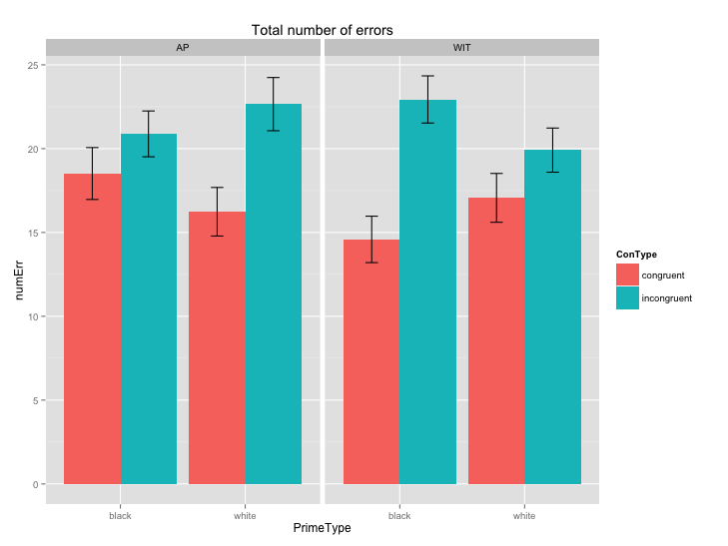
BAD SUBJECTS EXCLUDED
Total errors
AP
Main effect of TargetType: p = .003
- neg > pos
PrimeType*TargetType: p < .001
- All pairwise comp. sig
WIT
Main effect of TargetType: p < .001
- tool > gun
PrimeType*TargetType: p < .001
All pairwise comp. sig
Comparing tasks
PrimeType*ConType*Task: p< .001
WIT: 92 subjects
AP: 93 subjects

Slide 11
PrimeType*ConType*Task (looking at whether pattern of interaction (race bias) is different across tasks
Error: Subject
Df Sum Sq Mean Sq F value Pr(>F)
Residuals 89 15015 168.7
Error: Subject:PrimeType
Df Sum Sq Mean Sq F value Pr(>F)
PrimeType 1 17.1 17.11 1.693 0.197
Residuals 89 899.5 10.11
Error: Subject:ConType
Df Sum Sq Mean Sq F value Pr(>F)
ConType 1 4656 4656 104.3 <2e-16 ***
Residuals 89 3972 45
---
Signif. codes: 0 ‘***’ 0.001 ‘**’ 0.01 ‘*’ 0.05 ‘.’ 0.1 ‘ ’ 1
Significant 3 way interaction:
Pattern of race bias (interaction between prime and target) differs across two tasks
Error: Subject:Task
Df Sum Sq Mean Sq F value Pr(>F)
Task 1 82 82.01 2.634 0.108
Residuals 89 2772 31.14
Error: Subject:PrimeType:ConType
Df Sum Sq Mean Sq F value Pr(>F)
PrimeType:ConType 1 28 28.40 0.678 0.413
Residuals 89 3730 41.91
Error: Subject:PrimeType:Task
Df Sum Sq Mean Sq F value Pr(>F)
PrimeType:Task 1 0.2 0.168 0.017 0.898
Residuals 89 906.0 10.179
Error: Subject:ConType:Task
Df Sum Sq Mean Sq F value Pr(>F)
ConType:Task 1 56.1 56.11 1.814 0.181
Residuals 89 2752.5 30.93
Error: Subject:PrimeType:ConType:Task
Df Sum Sq Mean Sq F value Pr(>F)
PrimeType:ConType:Task 1 992 991.7 23.04 6.35e-06 ***
Residuals 89 3830 43.0

Slide 12
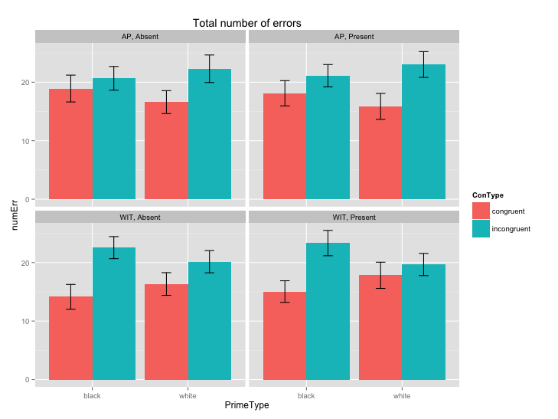
BAD SUBJECTS EXCLUDED
Total errors
AP
Observer effect not significant, nor any interactions with Observer
(see next slides)
WIT
Observer effect not significant, nor any interactions with Observer
(see next slides)
WIT: 45 present, 47 absent Ss
AP: 46 present, 47 absent Ss

Slide 13
AP
Error: Subject
Df Sum Sq Mean Sq F value Pr(>F)
Observer 1 1 0.75 0.007 0.935
Residuals 91 10154 111.58
Error: Subject:PrimeType
Df Sum Sq Mean Sq F value Pr(>F)
PrimeType 1 5.9 5.938 0.527 0.470
PrimeType:Observer 1 0.7 0.731 0.065 0.799
Residuals 91 1025.1 11.265
Error: Subject:TargetType
Df Sum Sq Mean Sq F value Pr(>F)
TargetType 1 382 382.1 8.850 0.00375 **
TargetType:Observer 1 0 0.2 0.005 0.94320
Residuals 91 3928 43.2
---
Signif. codes: 0 ‘***’ 0.001 ‘**’ 0.01 ‘*’ 0.05 ‘.’ 0.1 ‘ ’ 1
Error: Subject:PrimeType:TargetType
Df Sum Sq Mean Sq F value Pr(>F)
PrimeType:TargetType 1 1794 1794.3 39.797 1e-08 ***
PrimeType:TargetType:Observer 1 43 42.5 0.943 0.334
Residuals 91 4103 45.1

Slide 14
WIT
Error: Subject
Df Sum Sq Mean Sq F value Pr(>F)
Observer 1 41 41.13 0.414 0.522
Residuals 90 8949 99.43
Error: Subject:PrimeType
Df Sum Sq Mean Sq F value Pr(>F)
PrimeType 1 6.8 6.793 0.736 0.393
PrimeType:Observer 1 2.6 2.627 0.285 0.595
Residuals 90 831.1 9.234
Error: Subject:TargetType
Df Sum Sq Mean Sq F value Pr(>F)
TargetType 1 696 695.8 16.134 0.000122 ***
TargetType:Observer 1 20 19.6 0.455 0.501468
Residuals 90 3881 43.1
---
Signif. codes: 0 ‘***’ 0.001 ‘**’ 0.01 ‘*’ 0.05 ‘.’ 0.1 ‘ ’ 1
Error: Subject:PrimeType:TargetType
Df Sum Sq Mean Sq F value Pr(>F)
PrimeType:TargetType 1 2882.9 2882.9 96.32 6.95e-16 ***
PrimeType:TargetType:Observer 1 24.9 24.9 0.83 0.365
Residuals 90 2693.8 29.9

Slide 15
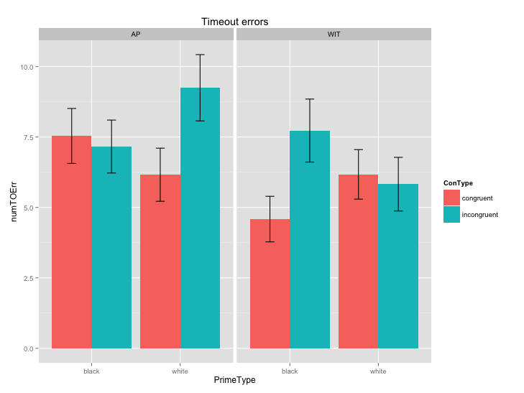
BAD SUBJECTS EXCLUDED
Timeout errors
AP
Main effect of TargetType: p = .003
- neg > pos
PrimeType*TargetType: p < .001
WIT
Main effect of TargetType: p < .001
- tool > gun
PrimeType*TargetType: p < .001
All pairwise comp. sig
Comparing tasks
Main effect of task: p = .007
AP > WIT
PrimeType*ConType*Task: p< .001
***
-
***
***
-
WIT: 45 present, 47 absent Ss
AP: 46 present, 47 absent Ss

Slide 16
PrimeType*ConType*Task (looking at whether pattern of interaction (race bias) is different across tasks
Error: Subject
Df Sum Sq Mean Sq F value Pr(>F)
Residuals 89 8300 93.26
Error: Subject:PrimeType
Df Sum Sq Mean Sq F value Pr(>F)
PrimeType 1 0.9 0.939 0.154 0.696
Residuals 89 542.3 6.093
Error: Subject:ConType
Df Sum Sq Mean Sq F value Pr(>F)
ConType 1 350.0 350.0 46.51 1.06e-09 ***
Residuals 89 669.7 7.5
Significant 3 way interaction:
Pattern of race bias (interaction between prime and target) differs across two tasks
Error: Subject:Task
Df Sum Sq Mean Sq F value Pr(>F)
Task 1 259.2 259.20 7.568 0.0072 **
Residuals 89 3048.0 34.25
---
Signif. codes: 0 ‘***’ 0.001 ‘**’ 0.01 ‘*’ 0.05 ‘.’ 0.1 ‘ ’ 1
Error: Subject:PrimeType:ConType
Df Sum Sq Mean Sq F value Pr(>F)
PrimeType:ConType 1 0.1 0.089 0.01 0.919
Residuals 89 766.7 8.614
Error: Subject:PrimeType:Task
Df Sum Sq Mean Sq F value Pr(>F)
PrimeType:Task 1 9.3 9.339 2.278 0.135
Residuals 89 364.9 4.100
Error: Subject:ConType:Task
Df Sum Sq Mean Sq F value Pr(>F)
ConType:Task 1 0.9 0.939 0.1 0.753
Residuals 89 837.8 9.414
Error: Subject:PrimeType:ConType:Task
Df Sum Sq Mean Sq F value Pr(>F)
PrimeType:ConType:Task 1 513.4 513.4 45.95 1.28e-09 ***
Residuals 89 994.3 11.2

Slide 17
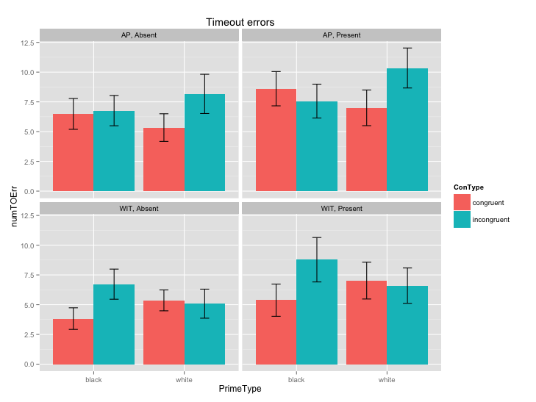
BAD SUBJECTS EXCLUDED
Timeout errors
AP
Observer effect marginally significant (p = .057)
No interactions with Observer
WIT
Observer effect significant
No interactions with Observer
WIT: 45 present, 47 absent Ss
AP: 46 present, 47 absent Ss

Slide 18
AP
Error: Subject
Df Sum Sq Mean Sq F value Pr(>F)
Observer 1 265 265.26 3.718 0.057 .
Residuals 91 6493 71.35
---
Signif. codes: 0 ‘***’ 0.001 ‘**’ 0.01 ‘*’ 0.05 ‘.’ 0.1 ‘ ’ 1
Error: Subject:PrimeType
Df Sum Sq Mean Sq F value Pr(>F)
PrimeType 1 11.7 11.710 2.532 0.115
PrimeType:Observer 1 4.9 4.904 1.060 0.306
Residuals 91 420.9 4.625
Error: Subject:TargetType
Df Sum Sq Mean Sq F value Pr(>F)
TargetType 1 278.7 278.72 33.767 9.06e-08 ***
TargetType:Observer 1 19.6 19.64 2.379 0.126
Residuals 91 751.1 8.25
---
Signif. codes: 0 ‘***’ 0.001 ‘**’ 0.01 ‘*’ 0.05 ‘.’ 0.1 ‘ ’ 1
Error: Subject:PrimeType:TargetType
Df Sum Sq Mean Sq F value Pr(>F)
PrimeType:TargetType 1 170.7 170.71 16.403 0.000108 ***
PrimeType:TargetType:Observer 1 3.7 3.74 0.359 0.550426
Residuals 91 947.1 10.41

Slide 19
WIT
Error: Subject
Df Sum Sq Mean Sq F value Pr(>F)
Observer 1 264 264.02 4.579 0.0351 *
Residuals 90 5189 57.66
---
Signif. codes: 0 ‘***’ 0.001 ‘**’ 0.01 ‘*’ 0.05 ‘.’ 0.1 ‘ ’ 1
Error: Subject:PrimeType
Df Sum Sq Mean Sq F value Pr(>F)
PrimeType 1 2.3 2.285 0.400 0.529
PrimeType:Observer 1 1.0 1.048 0.183 0.670
Residuals 90 514.4 5.716
Error: Subject:TargetType
Df Sum Sq Mean Sq F value Pr(>F)
TargetType 1 280.0 280.00 24.626 3.27e-06 ***
TargetType:Observer 1 2.4 2.44 0.215 0.644
Residuals 90 1023.3 11.37
---
Signif. codes: 0 ‘***’ 0.001 ‘**’ 0.01 ‘*’ 0.05 ‘.’ 0.1 ‘ ’ 1
Error: Subject:PrimeType:TargetType
Df Sum Sq Mean Sq F value Pr(>F)
PrimeType:TargetType 1 179.5 179.48 26.589 1.48e-06 ***
PrimeType:TargetType:Observer 1 0.7 0.75 0.111 0.74
Residuals 90 607.5 6.75

Slide 20
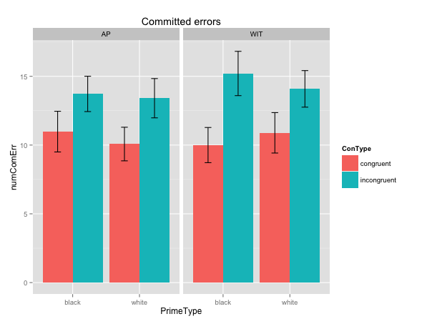
BAD SUBJECTS EXCLUDED
Committed errors
AP
Main effect of PrimeType: p = .047
- black > white
PrimeType*TargetType: p < .001
WIT
PrimeType*TargetType: p < .001
Comparing tasks
No effect of task, nor any interactions
WIT: 45 present, 47 absent Ss
AP: 46 present, 47 absent Ss

Slide 21
PrimeType*ConType*Task (looking at whether pattern of interaction (race bias) is different across tasks
Error: Subject
Df Sum Sq Mean Sq F value Pr(>F)
Residuals 89 15241 171.2
Error: Subject:PrimeType
Df Sum Sq Mean Sq F value Pr(>F)
PrimeType 1 26.1 26.068 2.914 0.0913 .
Residuals 89 796.1 8.944
---
Signif. codes: 0 ‘***’ 0.001 ‘**’ 0.01 ‘*’ 0.05 ‘.’ 0.1 ‘ ’ 1
Error: Subject:ConType
Df Sum Sq Mean Sq F value Pr(>F)
ConType 1 2453 2453.1 76.36 1.3e-13 ***
Residuals 89 2859 32.1
Error: Subject:Task
Df Sum Sq Mean Sq F value Pr(>F)
Task 1 50 49.61 0.951 0.332
Residuals 89 4644 52.17
Error: Subject:PrimeType:ConType
Df Sum Sq Mean Sq F value Pr(>F)
PrimeType:ConType 1 25 25.31 0.686 0.41
Residuals 89 3284 36.90
Error: Subject:PrimeType:Task
Df Sum Sq Mean Sq F value Pr(>F)
PrimeType:Task 1 12.0 12.012 1.317 0.254
Residuals 89 811.6 9.119
Error: Subject:ConType:Task
Df Sum Sq Mean Sq F value Pr(>F)
ConType:Task 1 42.5 42.53 2.141 0.147
Residuals 89 1768.1 19.87
Error: Subject:PrimeType:ConType:Task
Df Sum Sq Mean Sq F value Pr(>F)
PrimeType:ConType:Task 1 78 78.01 2.358 0.128
Residuals 89 2944 33.08

Slide 22
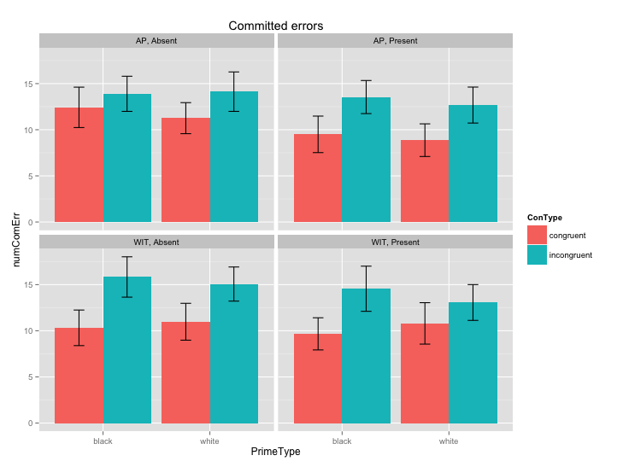
BAD SUBJECTS EXCLUDED
Committed errors
AP
Observer effect marginally significant (p = .096)
PrimeType*TargetType*Observer marginally significant (p = .091)
WIT
Observer effect not significant, nor any interactions with Observer
WIT: 45 present, 47 absent Ss
AP: 46 present, 47 absent Ss

Slide 23
AP
Error: Subject
Df Sum Sq Mean Sq F value Pr(>F)
Observer 1 294 294.2 2.827 0.0961 .
Residuals 91 9470 104.1
---
Signif. codes: 0 ‘***’ 0.001 ‘**’ 0.01 ‘*’ 0.05 ‘.’ 0.1 ‘ ’ 1
Error: Subject:PrimeType
Df Sum Sq Mean Sq F value Pr(>F)
PrimeType 1 34.3 34.33 4.025 0.0478 *
PrimeType:Observer 1 1.8 1.85 0.217 0.6427
Residuals 91 776.1 8.53
---
Signif. codes: 0 ‘***’ 0.001 ‘**’ 0.01 ‘*’ 0.05 ‘.’ 0.1 ‘ ’ 1
Error: Subject:TargetType
Df Sum Sq Mean Sq F value Pr(>F)
TargetType 1 8.1 8.13 0.236 0.628
TargetType:Observer 1 15.7 15.70 0.455 0.502
Residuals 91 3138.4 34.49
Error: Subject:PrimeType:TargetType
Df Sum Sq Mean Sq F value Pr(>F)
PrimeType:TargetType 1 858.1 858.1 34.992 5.74e-08 ***
PrimeType:TargetType:Observer 1 71.5 71.5 2.915 0.0911 .
Residuals 91 2231.6 24.5

Slide 24
WIT
Error: Subject
Df Sum Sq Mean Sq F value Pr(>F)
Observer 1 97 96.73 0.817 0.368
Residuals 90 10651 118.34
Error: Subject:PrimeType
Df Sum Sq Mean Sq F value Pr(>F)
PrimeType 1 1.2 1.198 0.128 0.722
PrimeType:Observer 1 0.4 0.357 0.038 0.846
Residuals 90 845.7 9.397
Error: Subject:TargetType
Df Sum Sq Mean Sq F value Pr(>F)
TargetType 1 93 93.00 2.562 0.113
TargetType:Observer 1 8 8.23 0.227 0.635
Residuals 90 3267 36.30
Error: Subject:PrimeType:TargetType
Df Sum Sq Mean Sq F value Pr(>F)
PrimeType:TargetType 1 1623.7 1623.7 60.479 1.17e-11 ***
PrimeType:TargetType:Observer 1 34.2 34.2 1.275 0.262
Residuals 90 2416.3 26.8

Slide 25
Performance bias

Slide 26
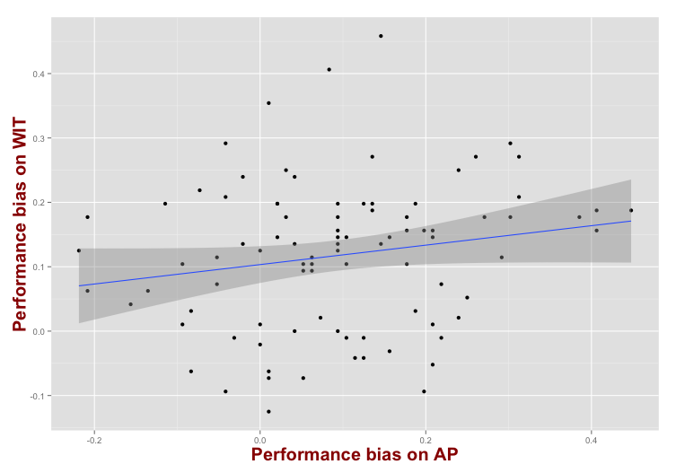
BAD SUBJECTS EXCLUDED (for both tasks)
Performance bias estimate =
P(errors|incongruent) – P(errors|congruent)
b = .23, F(1, 88) = 1.77, p = .08
R² = .03

Slide 27
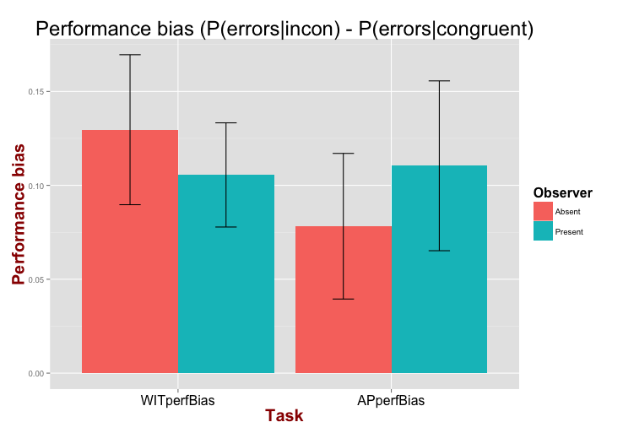
BAD SUBJECTS EXCLUDED (for both tasks)
Separated by observer condition
Error: Subject
Df Sum Sq Mean Sq F value Pr(>F)
Observer 1 0.0007 0.000738 0.038 0.846
Residuals 88 1.7231 0.019581
Error: Subject:Task
Df Sum Sq Mean Sq F value Pr(>F)
Task 1 0.0244 0.02435 1.849 0.177
Task:Observer 1 0.0356 0.03560 2.703 0.104
Residuals 88 1.1591 0.01317

Slide 28
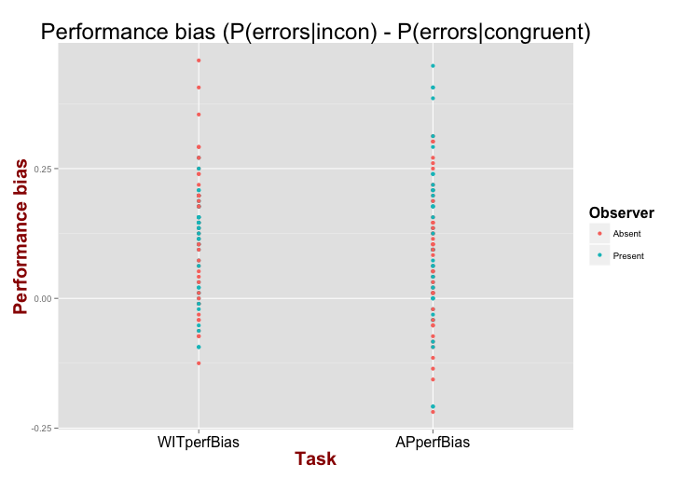
BAD SUBJECTS EXCLUDED (for both tasks)
Separated by observer condition

Slide 29
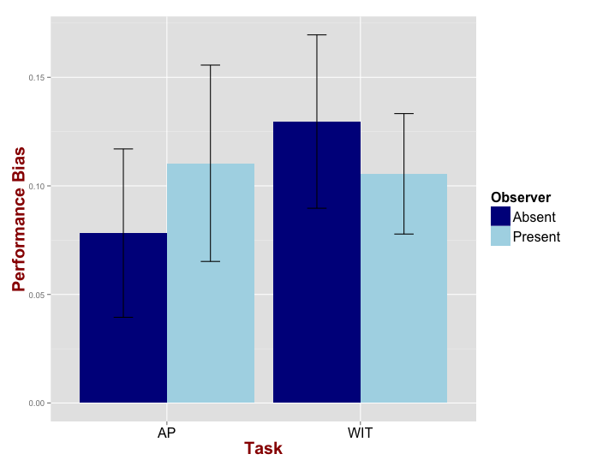
BAD SUBJECTS EXCLUDED (for both tasks)
Effect of observer on performance bias
Error: Subject
Df Sum Sq Mean Sq F value Pr(>F)
Observer 1 0.0007 0.000738 0.038 0.846
Residuals 88 1.7231 0.019581
Error: Subject:Task
Df Sum Sq Mean Sq F value Pr(>F)
Task 1 0.0244 0.02435 1.849 0.177
Observer:Task 1 0.0356 0.03560 2.703 0.104
Residuals 88 1.1591 0.01317

Slide 30
PDP analysis
Separate for Black/White trials (i.e. Black_A, Black_C) and collapsed across race (Total_A, Total_C)
No correlation between A and C within each task
C estimate highly correlated across prime race. A estimate also correlated but less so
Correlations of A and C estimates across tasks
Black C more correlated across tasks than Black A
Same for White trials
PDP bias estimate (Black_A – White_A) not correlated across tasks

Slide 31
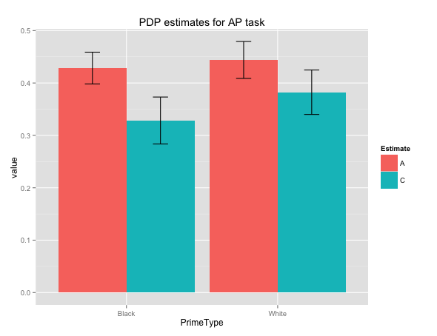
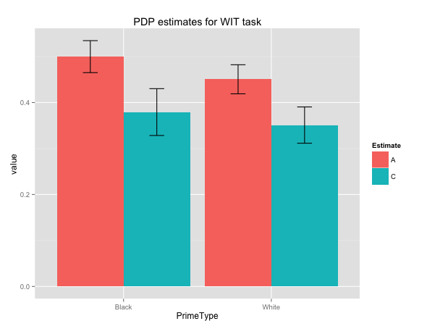
BAD SUBJECTS EXCLUDED (just for relevant task)
AP
WIT
p < .001
p = .02
p = .056
Main effect of Estimate ( p = .005)
White C > Black C (p < .001)
Main effect of Estimate ( p < .001)
Black A > White A (p = .02)
Black C > White C (p = .056)
Notes:
3 way interaction (Prime*Estimate*Task) is not significant
Error: Subject
Df Sum Sq Mean Sq F value Pr(>F)
Residuals 89 7.106 0.07985
Error: Subject:PrimeType
Df Sum Sq Mean Sq F value Pr(>F)
PrimeType 1 0.0007 0.000655 0.042 0.838
Residuals 89 1.3854 0.015567
Error: Subject:Estimate
Df Sum Sq Mean Sq F value Pr(>F)
Estimate 1 1.481 1.4811 15.25 0.000183 ***
Residuals 89 8.641 0.0971
---
Signif. codes: 0 ‘***’ 0.001 ‘**’ 0.01 ‘*’ 0.05 ‘.’ 0.1 ‘ ’ 1
Error: Subject:Task
Df Sum Sq Mean Sq F value Pr(>F)
Task 1 0.0695 0.06953 3.57 0.0621 .
Residuals 89 1.7335 0.01948
---
Signif. codes: 0 ‘***’ 0.001 ‘**’ 0.01 ‘*’ 0.05 ‘.’ 0.1 ‘ ’ 1
Error: Subject:PrimeType:Estimate
Df Sum Sq Mean Sq F value Pr(>F)
PrimeType:Estimate 1 0.0449 0.04491 3.004 0.0865 .
Residuals 89 1.3308 0.01495
---
Signif. codes: 0 ‘***’ 0.001 ‘**’ 0.01 ‘*’ 0.05 ‘.’ 0.1 ‘ ’ 1
Error: Subject:PrimeType:Task
Df Sum Sq Mean Sq F value Pr(>F)
PrimeType:Task 1 0.2401 0.24007 15.05 2e-04 ***
Residuals 89 1.4192 0.01595
---
Signif. codes: 0 ‘***’ 0.001 ‘**’ 0.01 ‘*’ 0.05 ‘.’ 0.1 ‘ ’ 1
Error: Subject:Estimate:Task
Df Sum Sq Mean Sq F value Pr(>F)
Estimate:Task 1 0.0406 0.04063 1.332 0.252
Residuals 89 2.7151 0.03051
Error: Subject:PrimeType:Estimate:Task
Df Sum Sq Mean Sq F value Pr(>F)
PrimeType:Estimate:Task 1 0.0039 0.003948 0.293 0.589
Residuals 89 1.1981 0.013461

Slide 32
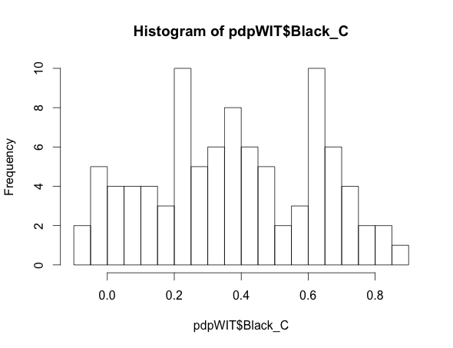
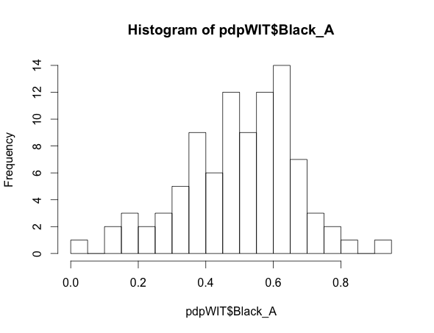
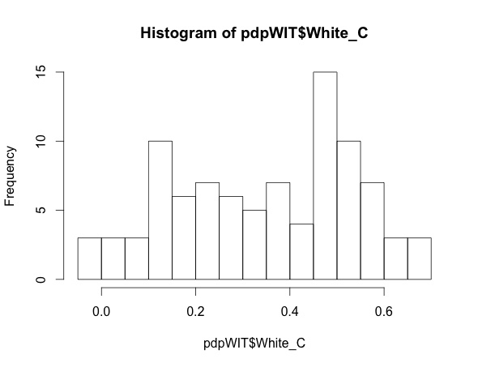
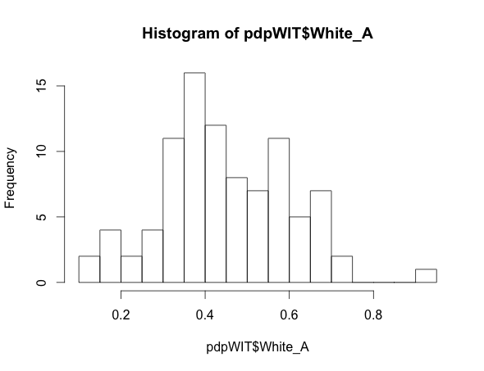
BAD SUBJECTS EXCLUDED (just for relevant task)
Histograms for A and C estimates in WIT

Slide 33
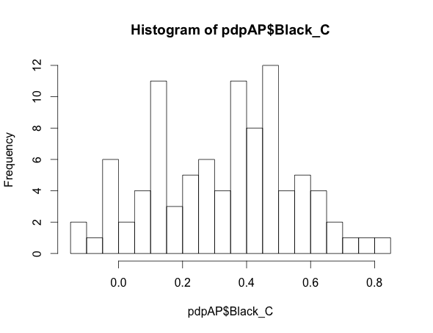
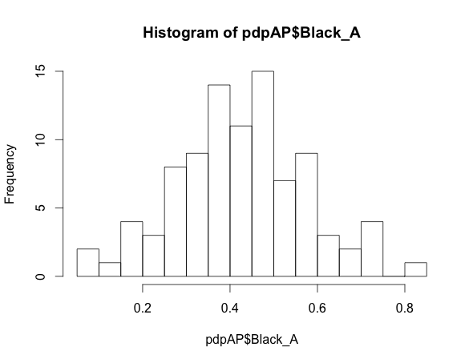
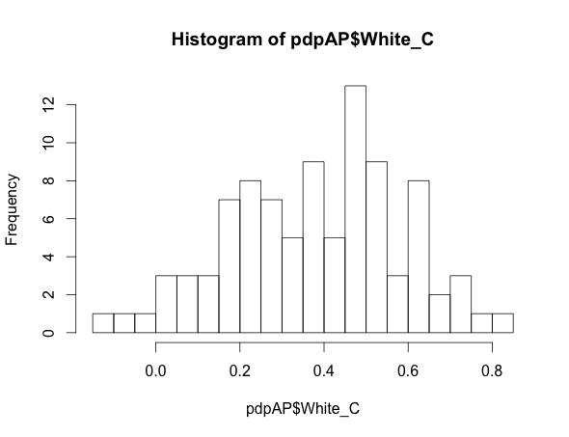
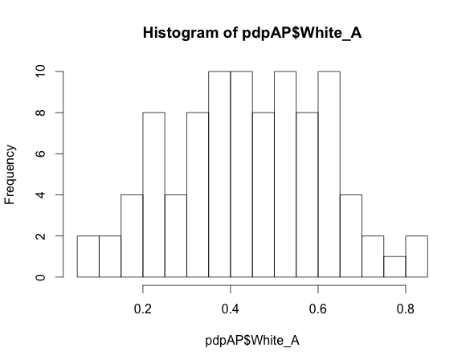
BAD SUBJECTS EXCLUDED (just for relevant task)
Histograms for A and C estimates in AP

Slide 34
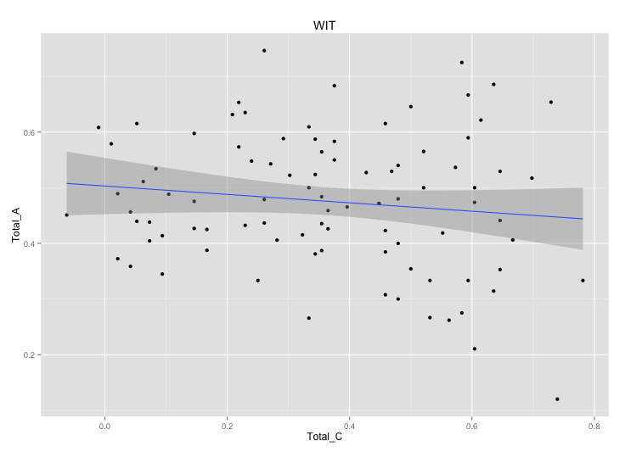
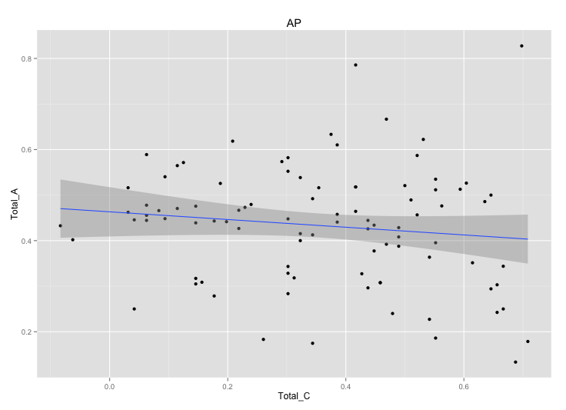
BAD SUBJECTS EXCLUDED (just for relevant task)
Correlation between A and C estimates within each task (Total_A ~ Total_C)
WIT:
Coefficients:
Estimate Std. Error t value Pr(>|t|)
(Intercept) 0.4715 0.0883 5.339 6.94e-07 ***
Total_A -0.2236 0.1800 -1.242 0.217
---
Signif. codes: 0 ‘***’ 0.001 ‘**’ 0.01 ‘*’ 0.05 ‘.’ 0.1 ‘ ’ 1
Residual standard error: 0.208 on 90 degrees of freedom
Multiple R-squared: 0.01685, Adjusted R-squared: 0.00593
F-statistic: 1.543 on 1 and 90 DF, p-value: 0.2174
AP:
Coefficients:
Estimate Std. Error t value Pr(>|t|)
(Intercept) 0.44383 0.07294 6.085 2.72e-08 ***
Total_A -0.20414 0.16146 -1.264 0.209
---
Signif. codes: 0 ‘***’ 0.001 ‘**’ 0.01 ‘*’ 0.05 ‘.’ 0.1 ‘ ’ 1
Residual standard error: 0.1996 on 91 degrees of freedom
Multiple R-squared: 0.01726, Adjusted R-squared: 0.006463
F-statistic: 1.598 on 1 and 91 DF, p-value: 0.2094

Slide 35
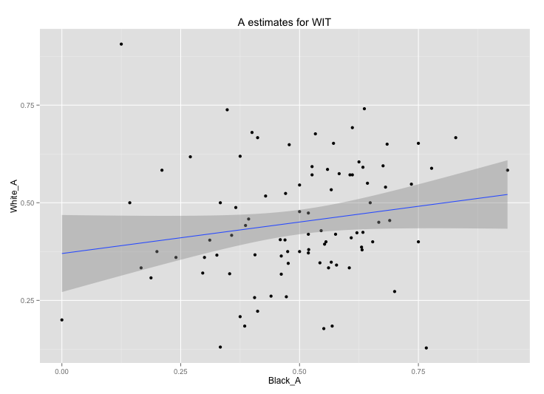
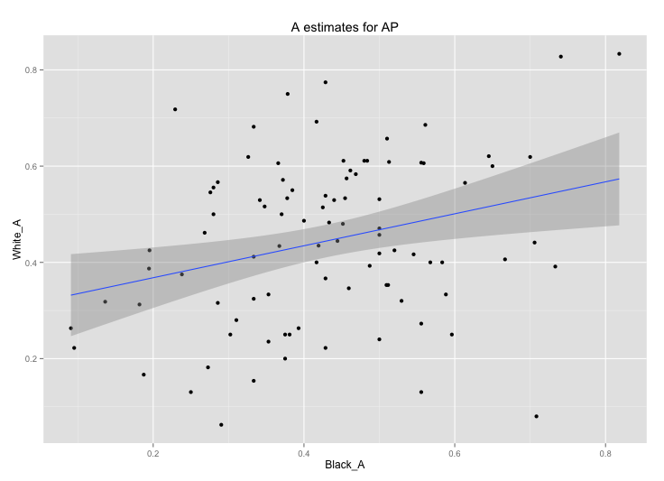
BAD SUBJECTS EXCLUDED (just for relevant task)
Correlation between A estimates across race of prime (White_A ~ Black_A)
WIT:
Coefficients:
Estimate Std. Error t value Pr(>|t|)
(Intercept) 0.37001 0.04967 7.449 5.5e-11 ***
Black_A 0.16122 0.09425 1.711 0.0906 .
Residual standard error: 0.1511 on 90 degrees of freedom
Multiple R-squared: 0.03149, Adjusted R-squared: 0.02073
F-statistic: 2.926 on 1 and 90 DF, p-value: 0.09059
AP:
Coefficients:
Estimate Std. Error t value Pr(>|t|)
(Intercept) 0.30167 0.05283 5.710 1.4e-07 ***
Black_A 0.33214 0.11665 2.847 0.00545 **
Residual standard error: 0.1648 on 91 degrees of freedom
Multiple R-squared: 0.0818, Adjusted R-squared: 0.07171
F-statistic: 8.107 on 1 and 91 DF, p-value: 0.00545

Slide 36
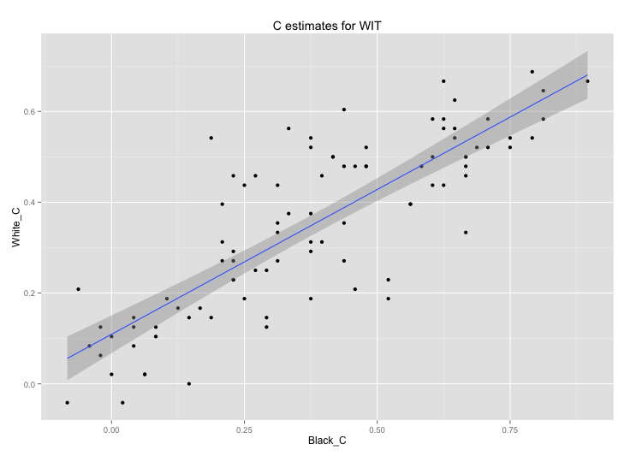
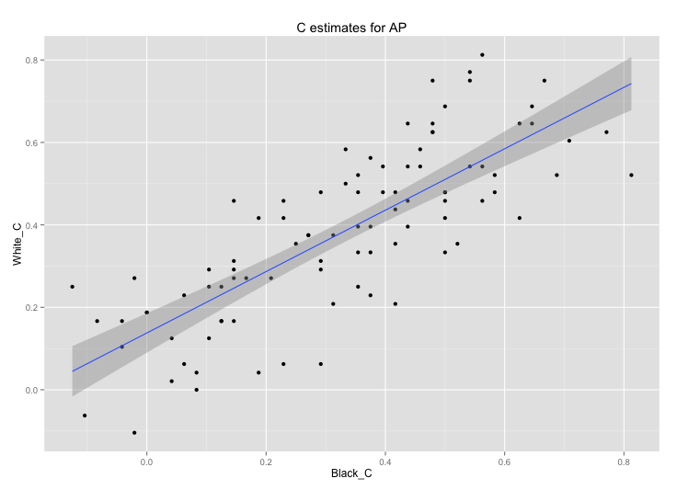
BAD SUBJECTS EXCLUDED (just for relevant task)
Correlation between C estimates across race of prime (White_C ~ Black_C)
WIT:
Coefficients:
Estimate Std. Error t value Pr(>|t|)
(Intercept) 0.10905 0.02092 5.213 1.17e-06 ***
Black_C 0.63786 0.04635 13.763 < 2e-16 ***
Residual standard error: 0.1088 on 90 degrees of freedom
Multiple R-squared: 0.6779, Adjusted R-squared: 0.6743
F-statistic: 189.4 on 1 and 90 DF, p-value: < 2.2e-16
AP:
Coefficients:
Estimate Std. Error t value Pr(>|t|)
(Intercept) 0.13782 0.02410 5.718 1.36e-07 ***
Black_C 0.74474 0.06129 12.152 < 2e-16 ***
Residual standard error: 0.1279 on 91 degrees of freedom
Multiple R-squared: 0.6187, Adjusted R-squared: 0.6145
F-statistic: 147.7 on 1 and 91 DF, p-value: < 2.2e-16

Slide 37
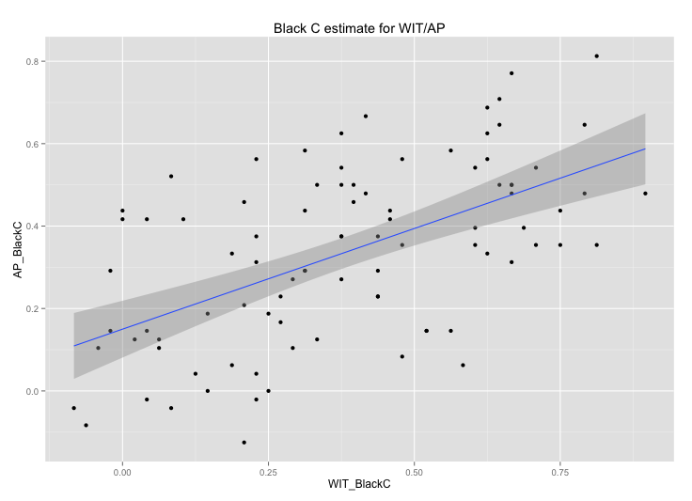
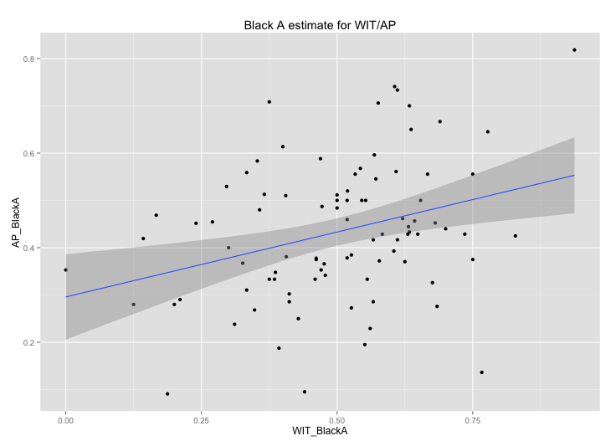
BAD SUBJECTS EXCLUDED (for both tasks)
Correlation between C and A estimates for Black trials across tasks
Black_C correlated across tasks
Black_A correlated across tasks
Coefficients:
Estimate Std. Error t value Pr(>|t|)
(Intercept) 0.16363 0.04051 4.039 0.000114 ***
AP_BlackC 0.65026 0.10160 6.400 7.32e-09 ***
Residual standard error: 0.2056 on 88 degrees of freedom
Multiple R-squared: 0.3176, Adjusted R-squared: 0.3099
F-statistic: 40.96 on 1 and 88 DF, p-value: 7.321e-09
Coefficients:
Estimate Std. Error t value Pr(>|t|)
(Intercept) 0.33660 0.05394 6.241 1.49e-08 ***
AP_BlackA 0.37620 0.11819 3.183 0.00201 **
Residual standard error: 0.1617 on 88 degrees of freedom
Multiple R-squared: 0.1032, Adjusted R-squared: 0.09306
F-statistic: 10.13 on 1 and 88 DF, p-value: 0.002015

Slide 38
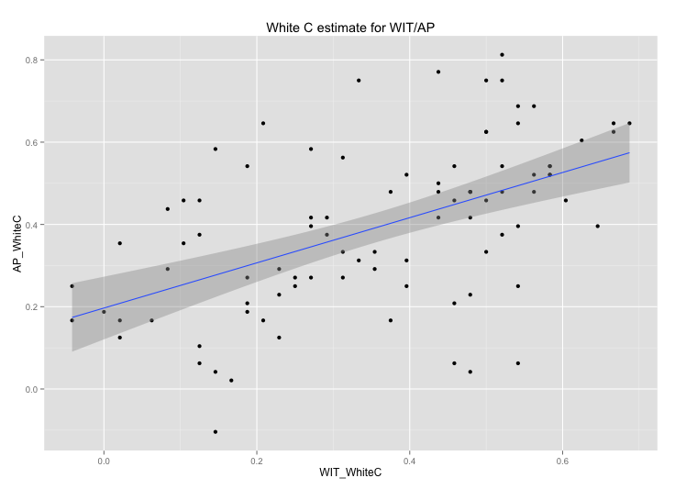
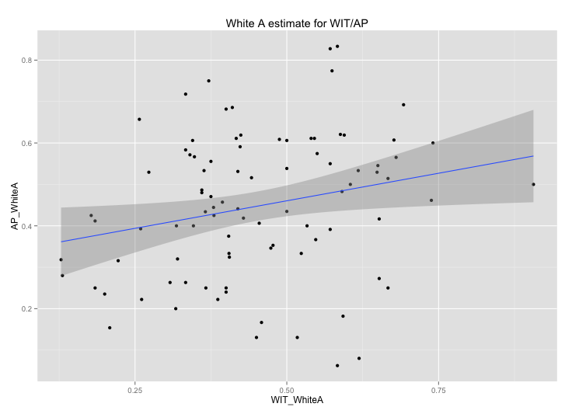
BAD SUBJECTS EXCLUDED (for both tasks)
Correlation between C and A estimates for White trials across tasks
White_C correlated across tasks
White_A correlated across tasks
Coefficients:
Estimate Std. Error t value Pr(>|t|)
(Intercept) 0.15976 0.03804 4.199 6.39e-05 ***
AP_WhiteC 0.49903 0.08658 5.764 1.20e-07 ***
Residual standard error: 0.1632 on 88 degrees of freedom
Multiple R-squared: 0.274, Adjusted R-squared: 0.2658
F-statistic: 33.22 on 1 and 88 DF, p-value: 1.196e-07
Coefficients:
Estimate Std. Error t value Pr(>|t|)
(Intercept) 0.35622 0.04405 8.087 3.08e-12 ***
AP_WhiteA 0.20962 0.09195 2.280 0.025 *
Residual standard error: 0.15 on 88 degrees of freedom
Multiple R-squared: 0.05577, Adjusted R-squared: 0.04504
F-statistic: 5.197 on 1 and 88 DF, p-value: 0.02504

Slide 39
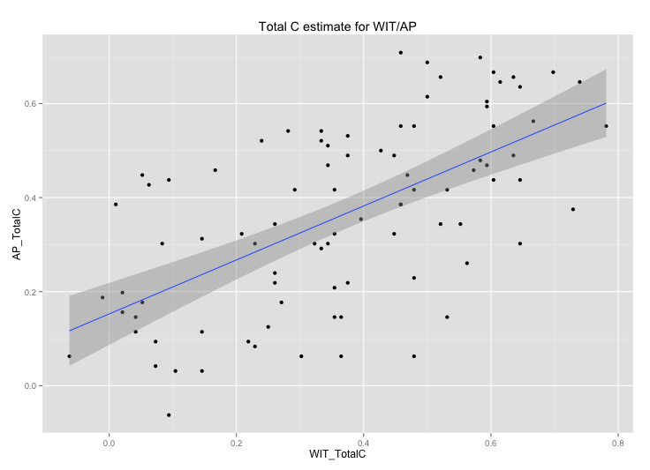
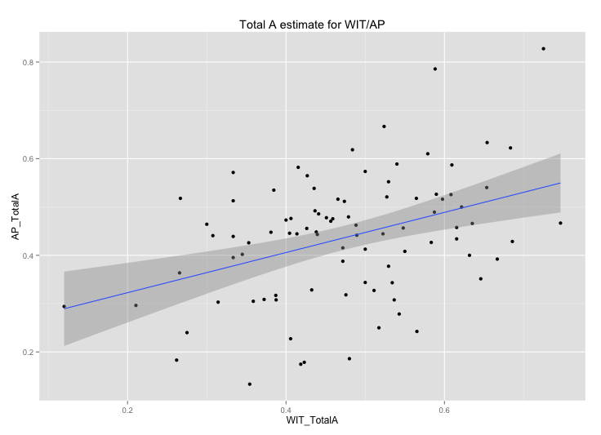
BAD SUBJECTS EXCLUDED (for both tasks)
Correlation between C and A estimates for all trials across tasks
Total_C correlated across tasks
Total_A correlated across tasks
Coefficients:
Estimate Std. Error t value Pr(>|t|)
(Intercept) 0.12833 0.03720 3.450 0.000863 ***
AP_TotalC 0.66049 0.09012 7.329 1.06e-10 ***
Residual standard error: 0.1658 on 88 degrees of freedom
Multiple R-squared: 0.379, Adjusted R-squared: 0.372
F-statistic: 53.72 on 1 and 88 DF, p-value: 1.062e-10
Coefficients:
Estimate Std. Error t value Pr(>|t|)
(Intercept) 0.31172 0.04230 7.368 8.85e-11 ***
AP_TotalA 0.37375 0.09293 4.022 0.000122 ***
Residual standard error: 0.1127 on 88 degrees of freedom
Multiple R-squared: 0.1553, Adjusted R-squared: 0.1457
F-statistic: 16.17 on 1 and 88 DF, p-value: 0.0001218

Slide 40
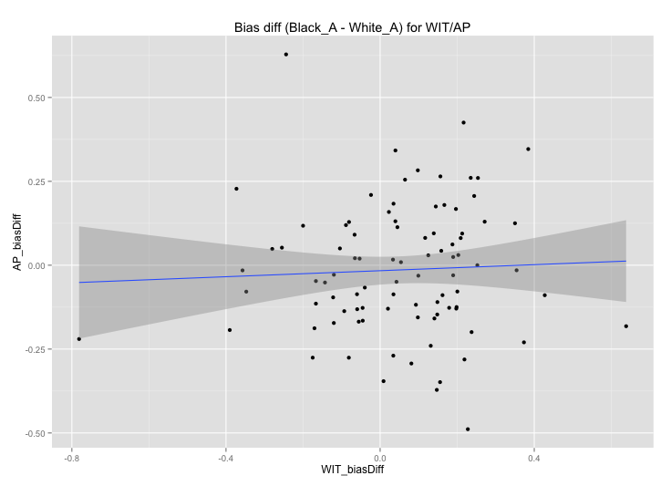
BAD SUBJECTS EXCLUDED (for both tasks)
Correlation between PDP bias estimate (Black_A – White_A) across tasks
Coefficients:
Estimate Std. Error t value Pr(>|t|)
(Intercept) 0.05028 0.02210 2.276 0.0253 *
AP_biasDiff 0.05265 0.11529 0.457 0.6490
Residual standard error: 0.2091 on 88 degrees of freedom
Multiple R-squared: 0.002364, Adjusted R-squared: -0.008973
F-statistic: 0.2085 on 1 and 88 DF, p-value: 0.649

Slide 41
PDP analysis separated by observer condition
Separate for Black/White trials (i.e. Black_A, Black_C) and collapsed across race (Total_A, Total_C)
Observer has effect on A estimate in WIT but not AP
No observer effect on C estimate in either task

Slide 42
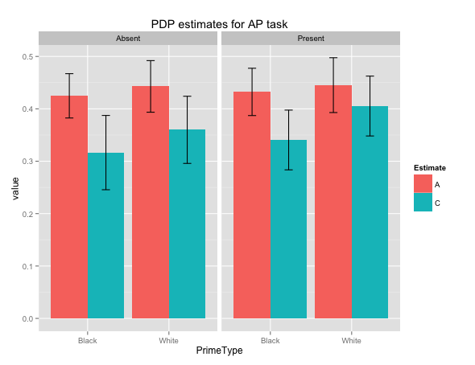
BAD SUBJECTS EXCLUDED (just for relevant task)
AP
Observer Absent
Observer Present
No effect of observer
No interactions with observer
No effect of observer specifically in C estimates
No effect of observer specifically in A estimates

Slide 43
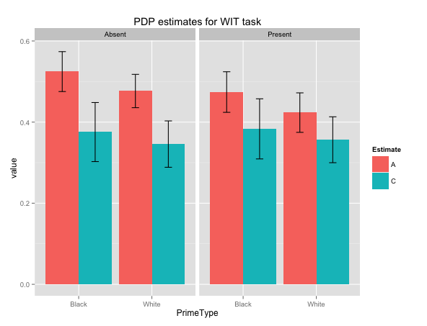
BAD SUBJECTS EXCLUDED (just for relevant task)
WIT
Observer Absent
Observer Present
No effect of observer
No interactions with observer
No effect of observer specifically in C estimates
Main effect of observer on A estimates (p = .04)

Slide 44
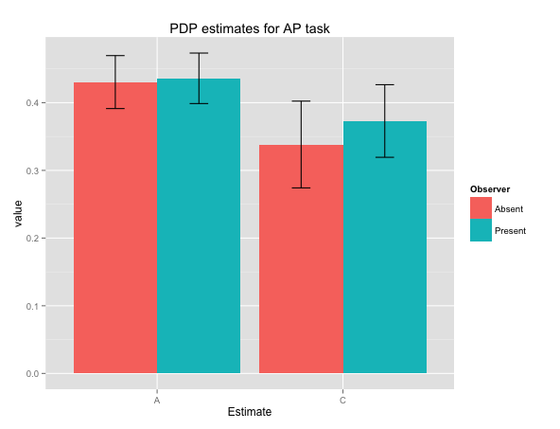
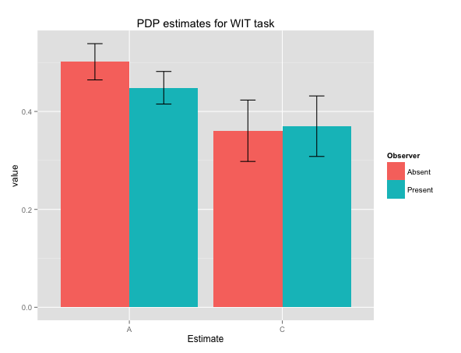
BAD SUBJECTS EXCLUDED (just for relevant task)
Total estimates (Total_A, Total_C) separated by observer condition
AP
*
WIT
No main effect of observer, or Estimate*Observer interaction in omnibus ANOVA (done separately for two tasks)
Main effect of Estimate in both tasks
Pairwise comparison of Observer within A estimate in WIT (p = .035)
Pairwise comparison of Observer with C estimate in AP not significant

Slide 45
How PDP estimates correlate with IMS/EMS scores
WIT
IMS correlates only marginally with White_A
EMS correlates marginally with Black_A, White_A and significantly with Total_A (p = .04)
AP
IMS/EMS doesn’t correlate with any PDP estimates
How that differs across condition
WIT: IMS/Observer interact in predicting Black_A, but not EMS/Observer in expected direction
AP: IMS/Observer interact in predicting Black_A (not significantly) but in opposite direction than WIT

Slide 46
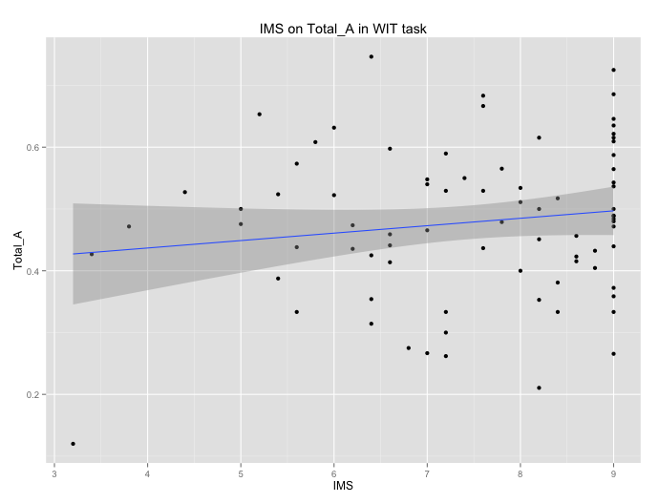
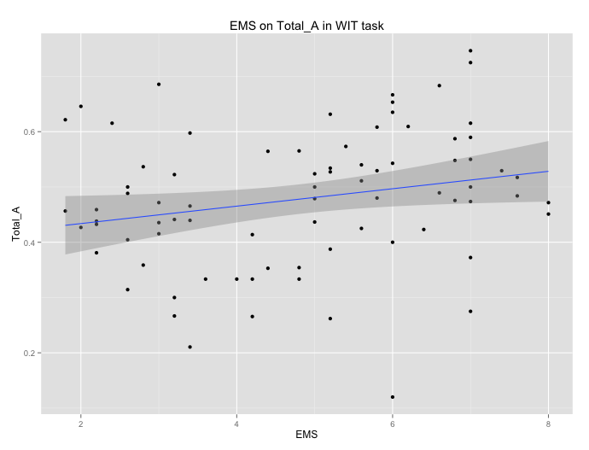
BAD SUBJECTS EXCLUDED (just for relevant task)
IMS and EMS predicting Total_A in WIT
IMS
EMS
Coefficients:
Estimate Std. Error t value Pr(>|t|)
(Intercept) 6.5805 0.6777 9.711 4.55e-15 ***
Total_A 1.8074 1.3728 1.317 0.192
Residual standard error: 1.498 on 78 degrees of freedom
(12 observations deleted due to missingness)
Multiple R-squared: 0.02174, Adjusted R-squared: 0.009196
F-statistic: 1.733 on 1 and 78 DF, p-value: 0.1919
Coefficients:
Estimate Std. Error t value Pr(>|t|)
(Intercept) 3.2264 0.7924 4.072 0.000111 ***
Total_A 3.3422 1.6053 2.082 0.040620 *
Residual standard error: 1.752 on 78 degrees of freedom
(12 observations deleted due to missingness)
Multiple R-squared: 0.05265, Adjusted R-squared: 0.0405
F-statistic: 4.335 on 1 and 78 DF, p-value: 0.04062
Notes:
Must not be standardized estimates??
Black_A ~ EMC* Observer is marginally significant

Slide 47
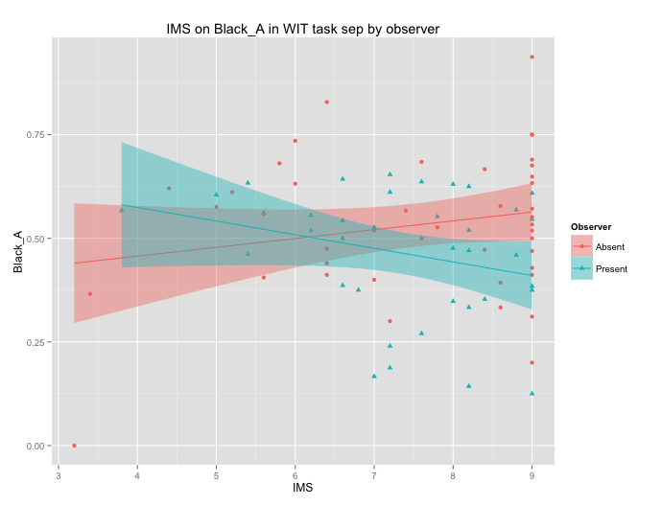
BAD SUBJECTS EXCLUDED (just for relevant task)
IMS predicting Black_A in WIT, separated by observer
IMS
Coefficients:
Estimate Std. Error t value Pr(>|t|)
(Intercept) 6.4082 0.7498 8.546 9.88e-13 ***
Black_A 2.0757 1.3441 1.544 0.1267
ObserverPresent 1.9998 1.0868 1.840 0.0697 .
Black_A:ObserverPresent -4.3192 2.0988 -2.058 0.0430 *
---
Signif. codes: 0 ‘***’ 0.001 ‘**’ 0.01 ‘*’ 0.05 ‘.’ 0.1 ‘ ’ 1
Residual standard error: 1.491 on 76 degrees of freedom
(12 observations deleted due to missingness)
Multiple R-squared: 0.05599, Adjusted R-squared: 0.01873
F-statistic: 1.503 on 3 and 76 DF, p-value: 0.2207
Notes:
Similar pattern for Total_A but not significant
Simple slope for Observer Present condition is negative but not significant
Coefficients:
Estimate Std. Error t value Pr(>|t|)
(Intercept) 8.4079 0.6562 12.813 8.94e-15 ***
Black_A -2.2435 1.3446 -1.668 0.104
---
Signif. codes: 0 ‘***’ 0.001 ‘**’ 0.01 ‘*’ 0.05 ‘.’ 0.1 ‘ ’ 1
Residual standard error: 1.244 on 35 degrees of freedom
(8 observations deleted due to missingness)
Multiple R-squared: 0.07368, Adjusted R-squared: 0.04721
F-statistic: 2.784 on 1 and 35 DF, p-value: 0.1041

Slide 48

BAD SUBJECTS EXCLUDED (just for relevant task)
EMS predicting Black_A in WIT, separated by observer
EMS
Coefficients:
Estimate Std. Error t value Pr(>|t|)
(Intercept) 4.6806 0.5227 8.954 1.63e-13 ***
Black_C 0.5573 1.1382 0.490 0.626
ObserverPresent 0.2818 0.7453 0.378 0.706
Black_C:ObserverPresent -1.1739 1.6695 -0.703 0.484
---
Signif. codes: 0 ‘***’ 0.001 ‘**’ 0.01 ‘*’ 0.05 ‘.’ 0.1 ‘ ’ 1
Residual standard error: 1.816 on 76 degrees of freedom
(12 observations deleted due to missingness)
Multiple R-squared: 0.008397, Adjusted R-squared: -0.03075
F-statistic: 0.2145 on 3 and 76 DF, p-value: 0.8861
Notes:
Black_C estimate doesn’t match regression run when just Black_C was predictor….. Is that a problem?

Slide 49


BAD SUBJECTS EXCLUDED (just for relevant task)
IMS and EMS predicting Black_A in AP
IMS
EMS
Coefficients:
Estimate Std. Error t value Pr(>|t|)
(Intercept) 7.0296 0.5532 12.708 <2e-16 ***
Black_A 0.9196 1.2227 0.752 0.454
Residual standard error: 1.603 on 79 degrees of freedom
(12 observations deleted due to missingness)
Multiple R-squared: 0.007109, Adjusted R-squared: -0.005459
F-statistic: 0.5656 on 1 and 79 DF, p-value: 0.4542
Coefficients:
Estimate Std. Error t value Pr(>|t|)
(Intercept) 4.1492 0.6241 6.649 3.48e-09 ***
Black_A 1.5539 1.3794 1.126 0.263
Residual standard error: 1.808 on 79 degrees of freedom
(12 observations deleted due to missingness)
Multiple R-squared: 0.01581, Adjusted R-squared: 0.003351
F-statistic: 1.269 on 1 and 79 DF, p-value: 0.2634
Notes:
Must not be standardized estimates??
Black_A ~ EMC* Observer is marginally significant

Slide 50

BAD SUBJECTS EXCLUDED (just for relevant task)
IMS predicting Black_A in AP, separated by observer
IMS
Coefficients:
Estimate Std. Error t value Pr(>|t|)
(Intercept) 7.9316 0.7429 10.677 <2e-16 ***
Black_A -0.7947 1.6369 -0.485 0.629
ObserverPresent -1.9739 1.1011 -1.793 0.077 .
Black_A:ObserverPresent 3.7802 2.4351 1.552 0.125
Residual standard error: 1.589 on 77 degrees of freedom
(12 observations deleted due to missingness)
Multiple R-squared: 0.04931, Adjusted R-squared: 0.01227
F-statistic: 1.331 on 3 and 77 DF, p-value: 0.2704
Notes:
Simple slope for Observer Present condition is marginally significant
Coefficients:
Estimate Std. Error t value Pr(>|t|)
(Intercept) 5.9578 0.7459 7.987 1.74e-09 ***
Black_A 2.9855 1.6547 1.804 0.0796 .
---
Signif. codes: 0 ‘***’ 0.001 ‘**’ 0.01 ‘*’ 0.05 ‘.’ 0.1 ‘ ’ 1
Residual standard error: 1.458 on 36 degrees of freedom
(8 observations deleted due to missingness)
Multiple R-squared: 0.08293, Adjusted R-squared: 0.05746
F-statistic: 3.256 on 1 and 36 DF, p-value: 0.07955

Slide 51

BAD SUBJECTS EXCLUDED (just for relevant task)
EMS predicting Black_A in AP, separated by observer
EMS
Coefficients:
Estimate Std. Error t value Pr(>|t|)
(Intercept) 4.6548 0.4688 9.930 1.96e-15 ***
Black_C 0.8335 1.1472 0.727 0.470
ObserverPresent -0.7319 0.7413 -0.987 0.327
Black_C:ObserverPresent 1.4505 1.8734 0.774 0.441
---
Signif. codes: 0 ‘***’ 0.001 ‘**’ 0.01 ‘*’ 0.05 ‘.’ 0.1 ‘ ’ 1
Residual standard error: 1.808 on 77 degrees of freedom
(12 observations deleted due to missingness)
Multiple R-squared: 0.04085, Adjusted R-squared: 0.003481
F-statistic: 1.093 on 3 and 77 DF, p-value: 0.3572

Slide 52
Relationship between PDP_C and self-reported effort/attention
AP: effort (marg. Sig), attention (sig)
WIT: both effort and attention significant
Relationship between PDP_A and self reported effort/attention
No significant relationships

Slide 53

BAD SUBJECTS EXCLUDED
AP:
Total_C estimate and self-reported effort: both observer conditions
Marginally significant
Not significant when separated out by observer
Coefficients:
Estimate Std. Error t value Pr(>|t|)
(Intercept) 0.13817 0.12062 1.145 0.2550
Effort 0.03693 0.02021 1.827 0.0709 .
Residual standard error: 0.1977 on 91 degrees of freedom
Multiple R-squared: 0.0354, Adjusted R-squared: 0.0248
F-statistic: 3.34 on 1 and 91 DF, p-value: 0.07091

Slide 54

BAD SUBJECTS EXCLUDED
AP:
Total_C estimate and self-reported attention: both observer conditions
Significant (p = .03)
Not significant when separated out by observer
Coefficients:
Estimate Std. Error t value Pr(>|t|)
(Intercept) 0.15627 0.09552 1.636 0.1053
Attend 0.03582 0.01679 2.134 0.0356 *
Residual standard error: 0.1964 on 91 degrees of freedom
Multiple R-squared: 0.04764, Adjusted R-squared: 0.03718
F-statistic: 4.553 on 1 and 91 DF, p-value: 0.03556

Slide 55

BAD SUBJECTS EXCLUDED
AP:
Total_A estimate and self-reported effort: both observer conditions
Not significant
Not significant when separated out by observer
Coefficients:
Estimate Std. Error t value Pr(>|t|)
(Intercept) 5.9381 0.3748 15.844 <2e-16 ***
Total_A -0.1302 0.8296 -0.157 0.876
Residual standard error: 1.025 on 91 degrees of freedom
Multiple R-squared: 0.0002707, Adjusted R-squared: -0.01072
F-statistic: 0.02464 on 1 and 91 DF, p-value: 0.8756

Slide 56

BAD SUBJECTS EXCLUDED
AP:
Total_A estimate and self-reported attention: both observer conditions
Not significant
Not significant when separated out by observer
Coefficients:
Estimate Std. Error t value Pr(>|t|)
(Intercept) 0.50979 0.06246 8.162 1.77e-12 ***
Attend -0.01378 0.01098 -1.255 0.213
Residual standard error: 0.1285 on 91 degrees of freedom
Multiple R-squared: 0.01701, Adjusted R-squared: 0.006212
F-statistic: 1.575 on 1 and 91 DF, p-value: 0.2127

Slide 57

BAD SUBJECTS EXCLUDED
WIT:
Total_C estimate and self-reported effort: both observer conditions
Significant (p = .01)
Significant in observer absent (p = .046)
Not significant in observer present
Coefficients:
Estimate Std. Error t value Pr(>|t|)
(Intercept) 0.08480 0.11564 0.733 0.4653
Effort 0.04715 0.01912 2.466 0.0156 *
Residual standard error: 0.203 on 90 degrees of freedom
Multiple R-squared: 0.06329, Adjusted R-squared: 0.05289
F-statistic: 6.081 on 1 and 90 DF, p-value: 0.01556

Slide 58

BAD SUBJECTS EXCLUDED
WIT:
Total_C estimate and self-reported attention: both observer conditions
Significant (p = .03)
Not significant when separated out by observer
Marginally significant in observer absent
Coefficients:
Estimate Std. Error t value Pr(>|t|)
(Intercept) 0.14960 0.10148 1.474 0.1439
Attend 0.03821 0.01759 2.173 0.0324 *
Residual standard error: 0.2045 on 90 degrees of freedom
Multiple R-squared: 0.04984, Adjusted R-squared: 0.03928
F-statistic: 4.72 on 1 and 90 DF, p-value: 0.03243

Slide 59

BAD SUBJECTS EXCLUDED
WIT:
Total_A estimate and self-reported effort: both observer conditions
Not significant
Not significant when separated out by observer
Coefficients:
Estimate Std. Error t value Pr(>|t|)
(Intercept) 5.90480 0.47515 12.427 <2e-16 ***
Total_A 0.08591 0.96858 0.089 0.93
Residual standard error: 1.119 on 90 degrees of freedom
Multiple R-squared: 8.74e-05, Adjusted R-squared: -0.01102
F-statistic: 0.007867 on 1 and 90 DF, p-value: 0.9295

Slide 60

BAD SUBJECTS EXCLUDED
WIT:
Total_A estimate and self-reported attention: both observer conditions
Not significant
Not significant when separated out by observer
Coefficients:
Estimate Std. Error t value Pr(>|t|)
(Intercept) 0.426553 0.060215 7.084 3.01e-10 ***
Attend 0.008683 0.010436 0.832 0.408
Residual standard error: 0.1213 on 90 degrees of freedom
Multiple R-squared: 0.007634, Adjusted R-squared: -0.003392
F-statistic: 0.6924 on 1 and 90 DF, p-value: 0.4076

Slide 61
BAD SUBJECTS EXCLUDED- both tasks for all bad subs
Block order effect on Effort: F(1, 89) = 9.308, p = .003
Block 1: 6.10
Block 2: 5.79
Block order effect on Attend: F(1, 89) = 11.41, p = .001
Block 1: 5.81
Block 2: 5.48

Slide 63
BAD SUBJECTS EXCLUDED (for both tasks)
Correlation between C and A estimates for Black trials across tasks
Black_C correlated across tasks
Black_A correlated across tasks
Coefficients:
Estimate Std. Error t value Pr(>|t|)
(Intercept) 0.16363 0.04051 4.039 0.000114 ***
AP_BlackC 0.65026 0.10160 6.400 7.32e-09 ***
Residual standard error: 0.2056 on 88 degrees of freedom
Multiple R-squared: 0.3176, Adjusted R-squared: 0.3099
F-statistic: 40.96 on 1 and 88 DF, p-value: 7.321e-09
Coefficients:
Estimate Std. Error t value Pr(>|t|)
(Intercept) 0.33660 0.05394 6.241 1.49e-08 ***
AP_BlackA 0.37620 0.11819 3.183 0.00201 **
Residual standard error: 0.1617 on 88 degrees of freedom
Multiple R-squared: 0.1032, Adjusted R-squared: 0.09306
F-statistic: 10.13 on 1 and 88 DF, p-value: 0.002015

Slide 64
BAD SUBJECTS EXCLUDED (for both tasks)
Correlation between C and A estimates for White trials across tasks
White_C correlated across tasks
White_A correlated across tasks
Coefficients:
Estimate Std. Error t value Pr(>|t|)
(Intercept) 0.15976 0.03804 4.199 6.39e-05 ***
AP_WhiteC 0.49903 0.08658 5.764 1.20e-07 ***
Residual standard error: 0.1632 on 88 degrees of freedom
Multiple R-squared: 0.274, Adjusted R-squared: 0.2658
F-statistic: 33.22 on 1 and 88 DF, p-value: 1.196e-07
Coefficients:
Estimate Std. Error t value Pr(>|t|)
(Intercept) 0.35622 0.04405 8.087 3.08e-12 ***
AP_WhiteA 0.20962 0.09195 2.280 0.025 *
Residual standard error: 0.15 on 88 degrees of freedom
Multiple R-squared: 0.05577, Adjusted R-squared: 0.04504
F-statistic: 5.197 on 1 and 88 DF, p-value: 0.02504

Slide 65
BAD SUBJECTS EXCLUDED (for both tasks)
Correlation between C and A estimates for all trials across tasks
Total_C correlated across tasks
Total_A correlated across tasks
Coefficients:
Estimate Std. Error t value Pr(>|t|)
(Intercept) 0.12833 0.03720 3.450 0.000863 ***
AP_TotalC 0.66049 0.09012 7.329 1.06e-10 ***
Residual standard error: 0.1658 on 88 degrees of freedom
Multiple R-squared: 0.379, Adjusted R-squared: 0.372
F-statistic: 53.72 on 1 and 88 DF, p-value: 1.062e-10
Coefficients:
Estimate Std. Error t value Pr(>|t|)
(Intercept) 0.31172 0.04230 7.368 8.85e-11 ***
AP_TotalA 0.37375 0.09293 4.022 0.000122 ***
Residual standard error: 0.1127 on 88 degrees of freedom
Multiple R-squared: 0.1553, Adjusted R-squared: 0.1457
F-statistic: 16.17 on 1 and 88 DF, p-value: 0.0001218

Slide 66

BAD SUBJECTS EXCLUDED (for both tasks)
WIT/AP C and A estimates correlations for Black trials
lm(WIT ~ AP*Type, data = blackEst)
Coefficients:
Estimate Std. Error t value Pr(>|t|)
(Intercept) 0.33660 0.06170 5.456 1.63e-07 ***
AP 0.37620 0.13519 2.783 0.00598 **
TypeC -0.17297 0.07165 -2.414 0.01680 *
AP:TypeC 0.27406 0.16319 1.679 0.09485 .
Residual standard error: 0.185 on 176 degrees of freedom
Multiple R-squared: 0.3025, Adjusted R-squared: 0.2906
F-statistic: 25.44 on 3 and 176 DF, p-value: 1.015e-13
Lm(AP ~ WIT*Type, data = blackEst)
Coefficients:
Estimate Std. Error t value Pr(>|t|)
(Intercept) 0.29589 0.05248 5.639 6.71e-08 ***
WIT 0.27444 0.09952 2.758 0.00644 **
TypeC -0.14599 0.06098 -2.394 0.01772 *
WIT:TypeC 0.21402 0.12069 1.773 0.07791 .
Residual standard error: 0.1594 on 176 degrees of freedom
Multiple R-squared: 0.2992, Adjusted R-squared: 0.2873
F-statistic: 25.05 on 3 and 176 DF, p-value: 1.515e-13

Slide 67

BAD SUBJECTS EXCLUDED (for both tasks)
WIT/AP C and A estimates correlations for all trials
lm(WIT ~ AP*Type, data = TotalEst)
Coefficients:
Estimate Std. Error t value Pr(>|t|)
(Intercept) 0.31172 0.05322 5.857 2.27e-08 ***
AP 0.37375 0.11692 3.197 0.00165 **
TypeC -0.18339 0.06200 -2.958 0.00352 **
AP:TypeC 0.28674 0.14002 2.048 0.04207 *
Residual standard error: 0.1418 on 176 degrees of freedom
Multiple R-squared: 0.3822, Adjusted R-squared: 0.3717
F-statistic: 36.3 on 3 and 176 DF, p-value: < 2.2e-16
Lm(AP ~ WIT*Type, data = TotalEst)
Coefficients:
Estimate Std. Error t value Pr(>|t|)
(Intercept) 0.23958 0.05876 4.077 6.9e-05 ***
WIT 0.41542 0.11986 3.466 0.000664 ***
TypeC -0.08698 0.06579 -1.322 0.187856
WIT:TypeC 0.15847 0.13872 1.142 0.254855
Residual standard error: 0.1379 on 176 degrees of freedom
Multiple R-squared: 0.3433, Adjusted R-squared: 0.3321
F-statistic: 30.67 on 3 and 176 DF, p-value: 5.32e-16

